Slide 1

REVIEW | 2021–2026
LLM-Based Classification of Educational Content into Bloom's Taxonomy
A Review of Large Language Models for Cognitive Level Classification in Education
2021–2026 Literature Review
5 Studies Analyzed

Slide 2
Navigation
Table of Contents
01
Introduction & Background
02
Research Objectives
Bloom's Taxonomy framework and LLM capabilities
Scope and aims of the systematic review
03
Methodology
04
Study Characteristics
Overview of included studies and datasets
05
Quality Assessment
06
Classification Performance
CASP evaluation of study rigor
LLMs vs traditional models comparison
07
Meta-Analysis Results
08
Prompting Strategies
Statistical synthesis of accuracy data
Impact of different prompting approaches
09
Error Patterns & Biases
10
Discussion & Implications
Systematic errors and domain challenges
Principal findings and practical applications
11
Future Directions
12
Conclusions
Priority areas for continued research
Key takeaways and final synthesis

Slide 3
1.1
Introduction: Bloom's Taxonomy Framework
Hierarchical Cognitive Framework
The Challenge of Automation
Bloom's Taxonomy provides a hierarchical framework for classifying educational objectives and assessment items into six cognitive levels, ranging from basic recall to higher-order creative skills.
Automating Bloom's taxonomy classification is challenging due to:
Nuanced differences between adjacent cognitive levels
The Six Cognitive Levels
Expert judgment required for accurate classification
Create
Context-dependent interpretations
6
Produce new or original work
5
Evaluate
LLM Capabilities
Justify a stand or decision
Recent advances in Large Language Models (GPT-4, Claude, LLaMA) offer new capabilities:
4
Analyze
Draw connections among ideas
Zero-shot learning: Classify without task-specific training
Few-shot learning: Adapt with minimal examples
3
Apply
Natural language understanding of educational content
Use information in new situations
2
Understand
Explain ideas or concepts
1
Remember
Recall facts and basic concepts

Slide 4
1.2
Research Objectives & Scope
Primary Research Purpose
This systematic review synthesizes research from 2021 to 2026 on using Large Language Models—especially GPT-4 and contemporary models—to automatically classify educational content (exam questions, learning outcomes, teacher prompts) into Bloom's taxonomy categories.
Performance Evaluation
Thematic Analysis
1
Evaluate LLM performance using metrics like accuracy, F1-score, precision/recall, and Cohen's kappa
1
Examine prompt engineering strategies and their impact on classification accuracy
2
Compare LLM-based approaches to traditional supervised methods (BERT, SVM, Random Forest)
2
Identify domain-specific challenges across educational contexts
3
Investigate potential biases and error patterns in LLM classification
3
Assess zero-shot and few-shot learning capabilities without task-specific training

Slide 5
2.1
Methodology: Review Protocol
Inclusion Criteria
Study Selection Flow
1
LLM Requirements
Initial Search Results
Generative/foundation models with >100M parameters (GPT-3/4, Claude, LLaMA)
Multiple Sources
2
Target Task
Classifying educational text into Bloom's cognitive levels
3
Empirical Evaluation
After Duplicate Removal
Performance metrics: accuracy, precision/recall, F1, kappa
Title/Abstract Screening
4
Study Design
Experimental or observational (excluding editorials)
Full-Text Screening
Search Strategy
12 Candidate Papers
Sources: Google Scholar, IEEE Xplore, ACM Digital Library, arXiv, medRxiv
Keywords: "Bloom's taxonomy classification", "large language model", "GPT-4 education Bloom"
Final Inclusion
Timeframe: 2021–2026
5 Studies Selected
Language: English only
Study Types
Publication Years
4 Papers + 1 Preprint
2022–2026

Slide 6
2.2
Study Characteristics & Dataset Overview
Study (Year) | Educational Content | LLM Model | Performance
Li et al. (2022) | 21,380 course learning objectives (6 Bloom levels) | BERT-base (110M) fine-tuned | F1: 0.95, κ: 0.93
Almatrafi & Johri (2025) | 1,000 learning outcomes (balanced across 6 levels) | GPT-4 via API, no fine-tuning | Acc: 87%, F1: 0.88
Kumar et al. (2025) | 600 sentences: exam questions + outcomes | GPT-4, Claude, Gemini, LLaMA | GPT-4: 72% acc; SVM: 94%
Kim & Joo (2026) | 350 teacher questions from K-12 classroom audio | GPT-4 zero-shot + Whisper | Acc: 64.2%, κ: 0.547
Kazemi Vanhari et al. (2025) | 726 interview Q&A segments | GPT-4o-mini, LLaMA-3 8B | GPT-4: 53.7% acc
Dataset Sizes
Educational Contexts
Models Evaluated
Largest
21,380 items
• Course learning outcomes
• GPT-4 / GPT-4o-mini
Smallest
350 items
• Exam questions
• BERT / RoBERTa
• Teacher classroom questions
• LLaMA-3 8B
Median
726 items
• Interview responses
• Claude 3.5
• University & K-12 settings
• Gemini 1.5
Note: All studies used six cognitive categories (Remember, Understand, Apply, Analyze, Evaluate, Create) except medical exam studies which sometimes merged highest levels.

Slide 7
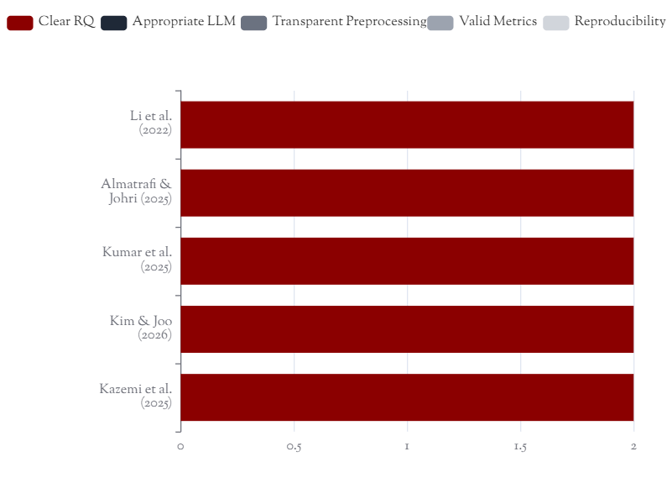
2.3
Quality Assessment Results
Assessment Methodology
Individual Study Scores
Quality assessment conducted using a modified CASP checklist with 5 domains, each scored 0–2 points (maximum 10 points).
Clear research question/objective
Appropriate LLM choice
Transparent preprocessing
Valid evaluation metrics
Reproducibility
Overall Quality
8–10
5/5
Score Range
Studies Passed
All studies exceeded quality threshold (≥7/10)

Slide 8
3.1
Classification Performance: LLMs vs Traditional Models
Fine-Tuned Models (With Training Data)
LLM Zero-Shot (No Training Required)
BERT (Li et al. 2022)
95% F1
GPT-4 + Rhetorical Prompt
87% Acc
21,380 training examples, κ = 0.93
Context-aware prompting, F1 = 0.88, κ ≈ 0.70
SVM + Augmentation (Kumar 2025)
94% Acc
GPT-4 Zero-Shot (Kumar 2025)
72% Acc
600 items with data augmentation
Mixed exam items, F1 ≈ 0.72
Fine-tuned BERT (Almatrafi 2025)
>90% Acc
GPT-4 Classroom Questions
64% Acc
1,000 learning outcomes
Transcribed teacher questions, κ = 0.547
Key Trade-off
Prompt Engineering Impact
Context Matters
Training data vs. flexibility: Fine-tuned models achieve 90-95% accuracy but require extensive labeled data. LLMs offer 70-87% accuracy with zero training.
Rhetorical context prompt improved GPT-4 from baseline to 87% accuracy—demonstrating significant impact of prompt design.
Performance varies by domain: structured exam items (87-94%) vs. conversational content (54-64%).

Slide 9
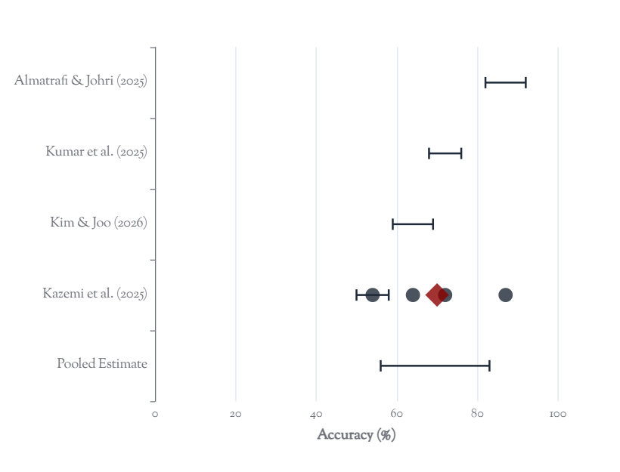
3.2
Meta-Analysis of Classification Accuracy
Meta-Analysis Summary
Forest Plot: LLM Classification Accuracy
Random-Effects Pooled Accuracy
~70%
95% CI: 56%–83%
Heterogeneity (I²)
~98%
Very high heterogeneity
Q-Test for Heterogeneity
Q = 142
p < 0.001 (significant)
Interpretation Caution
High heterogeneity indicates wide performance range. Prediction interval spans approximately 40%–90%, suggesting context-dependent effectiveness.

Slide 10
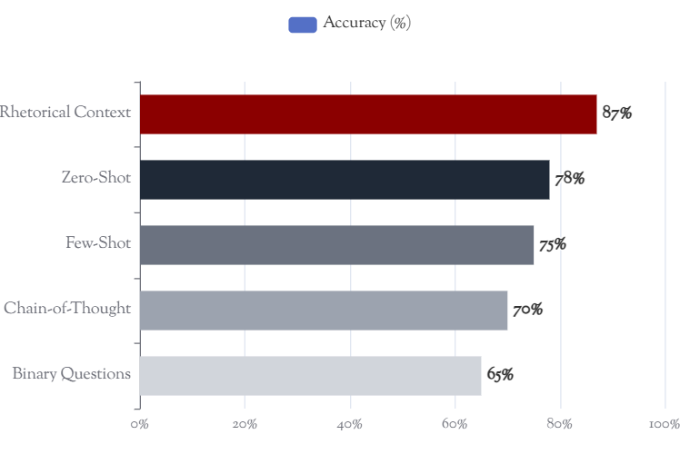
3.3
Prompting Strategies & Their Impact
Prompt Engineering Approaches
Prompt Strategy Performance Comparison
1
Zero-Shot Prompting
Approach: Direct classification without examples
Baseline performance: 53-72% accuracy depending on context
2
Few-Shot Prompting
Approach: Provide example question→level pairs
Slight improvement in precision; mixed results on overall F1
3
Chain-of-Thought (CoT)
Approach: Ask model to reason stepwise
Mixed outcomes; higher variance with smaller models
Best Performing Strategy
Rhetorical Situation Prompt: Framing classification with context (audience, domain, scenario) achieved 87% accuracy—highest among all approaches.
Rhetorical Prompt Structure
"Consider you are an instructor analyzing a course
outcome in [Domain] for [Audience]...
Classify this learning outcome into Bloom's taxonomy:
[Learning Outcome Text]"
Key insight: Domain-specific knowledge injection significantly improves classification accuracy.

Slide 11
3.4
Error Patterns, Biases & Domain Challenges
Consistent Error Patterns
Domain-Specific Challenges
1 Adjacent Level Confusion
Conversational Content
Most frequent error: Remember ↔ Understand
Interview responses: 54% accuracy
Even humans struggle with these boundaries
Long, unstructured text with mixed cognitive levels. Kendall's τ ~0.5 with humans.
2 Conservative Bias
Transcribed Speech
LLMs under-predict higher-order categories
Teacher questions: 64% accuracy
High precision for Create/Evaluate (1.0)
Speech recognition errors (Whisper) can mislead classification. Context inclusion helps mitigate.
Low recall—rarely assign these labels
Medical Education
3 Keyword Dependency
Multi-step reasoning: Recall fact → Apply to case
Models rely heavily on canonical action verbs ("define", "compare", "evaluate"), potentially misjudging creative phrasings.
Questions requiring multiple cognitive steps challenge classification.
Performance by Content Type
Structured exam items
87-94%
Learning outcomes
72-87%
Conversational content
54-64%

Slide 12
4.1
Discussion: Principal Findings
Key Findings Summary
Recent studies demonstrate that Large Language Models can automatically classify educational items by Bloom's cognitive categories with moderate to substantial success.
Performance Comparison
Well-defined contexts:
Traditional (with training)
90-95%
GPT-4 achieves 80-88% accuracy with substantial agreement (κ ≈ 0.6–0.7)
Complex contexts:
LLM (zero-shot, best case)
87%
Performance drops to 50-65% for conversational or noisy content
LLM (zero-shot, average)
~70%
Strengths of LLM Approaches
Limitations & Barriers
1
No Training Required
1
Accuracy Variance
Leverage pretraining knowledge for zero-shot classification—cost-effective when labeled data is scarce
Performance varies significantly by context (54-87%), limiting reliability for high-stakes decisions
2
Adaptability
2
Opacity
Same model adapts to different contexts via prompting (learning outcomes, exam questions, etc.)
Unlike keyword-based methods, GPT-4's reasoning is hidden, making debugging difficult
3
Cost & Access
3
Explanation Capability
API usage incurs costs and requires internet access—barriers for some institutions
Chain-of-thought reasoning can provide interpretable justifications for classifications
4
Open-Source Gap
4
Multi-Tasking
LLaMA and smaller models currently don't match GPT-4 accuracy
Single system can classify, generate questions, and evaluate answers

Slide 13
4.2
Future Research Directions
1
Larger & Diverse Datasets
3
Advanced Prompt Engineering
5
Bias & Fairness Analysis
Develop benchmark datasets for Bloom-labeled content that are large, diverse, and community-shared.
Build on rhetorical prompt success with pedagogically-informed frameworks.
Examine performance across demographic and linguistic subgroups.
Incorporate Bloom level definitions
Discipline-specific biases
Multiple subjects and disciplines
Multi-turn interactive protocols
Non-native English phrasings
Multilingual support
Explicit reasoning steps
Explainability requirements
Cross-institutional validation
2
4
Model Ensembling
6
Real-Time & Multimodal
Few-Shot Fine-Tuning
Explore parameter-efficient fine-tuning methods to specialize LLMs for Bloom classification.
Combine strengths of rule-based and LLM approaches for robust classification.
Extend to live classroom applications and student response analysis.
LoRA (Low-Rank Adaptation)
Keyword classifier for obvious cases
Real-time lecture analysis
Prompt tuning techniques
LLM for ambiguous content
Student answer classification
Adapter-based methods
Voting mechanisms
Live pilot studies
Integration Opportunity: Combine Bloom classification with content generation systems—LLM proposes questions, classifier validates cognitive level, creating automated quiz generation with guaranteed coverage.

Slide 14

CONCLUSIONS
Synthesis & Future Outlook
Principal Conclusions
Key Performance Metrics Summary
LLMs demonstrate considerable potential for automating Bloom's taxonomy classification, achieving 70-80% accuracy without task-specific training.
Fine-tuned BERT (best)
95% F1
GPT-4 + Rhetorical Prompt
87% Acc
Performance varies by context: Well-structured content (87%) vs. conversational content (54%).
GPT-4 Average (pooled)
~70% Acc
Prompt engineering significantly impacts accuracy—rhetorical context prompts achieved best results.
Trade-off exists: Fine-tuned models achieve 90-95% accuracy but require extensive data; LLMs offer flexibility with zero training.
Conversational Content
54% Acc
Path Forward
Future success depends on hybrid approaches combining LLMs with modest fine-tuning, improved prompt designs informed by pedagogy, and thorough real-world validation. The convergence of AI and educational psychology frameworks represents a fruitful interdisciplinary area for advancing learning analytics at scale.
Studies Reviewed
Time Period
5
2021-26
Automated Bloom-level classification is possible, although success hinges on matching model complexity to data volume and providing necessary support (augmentation, prompts).

